Slide 2
Meet Our Team

Slide 3
Webinar Notes
Please use the Q & A utility to ask us any questions concerning
the material being presented.
Please contact Brittany Socha- chat line or email brittany.socha@arisafety.com if you would like a copy of the presentation.

Slide 4
Automate Your Production Line – Learning Objectives
Software Solutions for Automation
Data collection and management
Software control and Remote Operation
Using Multiplexers (scanning matrices)
The need for multi-point testing
Multi-point testing
Examples of multi-point testing
Label Printing
Safety and Advantages

Slide 5
Common Electrical Safety Tests
Ground Continuity Test
Ground Bond Test
Dielectric Withstand Test (Hipot)
Insulation Resistance Test
Touch Current Test (Line Leakage Test)

Slide 6
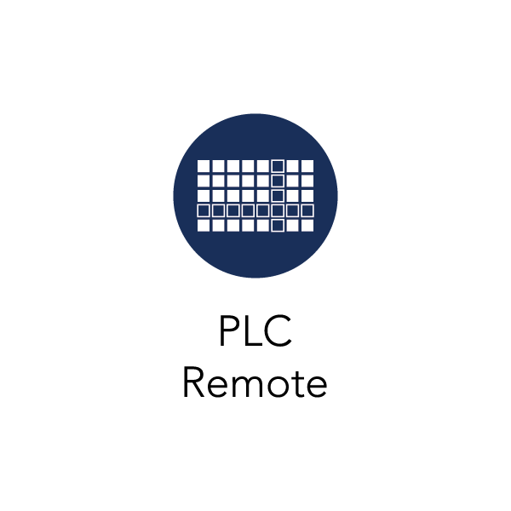
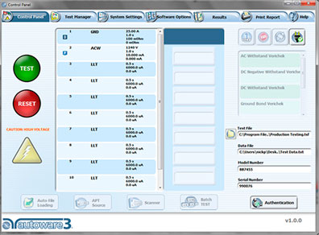
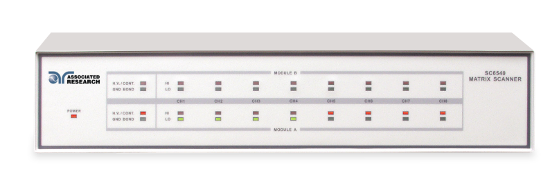
What is Automation?
Use of Control Software, PLC, or Multiplexer systems
Benefits of Automation
Minimize operator intervention
Reduce human error
Increased safety
Boost Productivity
Reduced Test Time
Test Data and Results Capturing

Slide 7
POLL QUESTION

Slide 8
6 Ways to Fully Automate Electrical Safety Testing
Multi-point Testing
Multi-DUT or Batch Testing
PLC Remote
LabVIEW/IVI Drivers
Autoware®3
Test Data and Results Capture

Slide 9
Automation
HARDWARE | SOFTWARE
Multiplexers (Scanning Matrices) – Multipoint Testing | Instrument Drivers – IVI and LabVIEW
PLC Control (Programmable Logical Controller) – Remote Control | Instrument Control Software – Autoware®3
USB – GPIB – ENET – RS232 | BatchTEST
 | Label and Test Report Printing

Slide 10
1. Multi-point Testing
The safety standard may require multiple points on single device to be tested for different types of tests
Too much operator intervention can lead to long test times, increased risk of operator error and operator safety
These devices may be tested in a production environment (high volume)
Sometimes all of the electrical safety tests are required to be performed on a single product/device

Slide 11
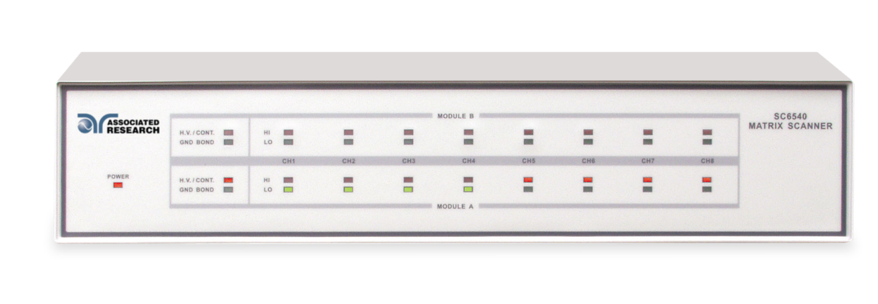
Using Multiplexers
Associated Research’s answer for multi-point testing is the model SC6540 scanning matrix
A modular scanning matrix with up to 16 high voltage or high current channels in a convenient 2U design
Can be customized in many different configurations for multi-point Hipot, Ground Bond, Insulation Resistance and Touch Current testing
The SC6540 can work with most of Associated Research’s safety test instruments to improve production line throughput or expand lab testing capability

Slide 12
Using Multiplexers
The SC6540 can be modified into the different configurations shown in the table below
These can be further divided into a master/slave configuration
This can potentially allow using large number of channels for testing
Model | Configuration
HH | 16 Port HV
HG | 8 Port HV, 8 Port GB
HN | 8 Port HV
GG | 16 Port GB
GN | 8 Port GB

Slide 13
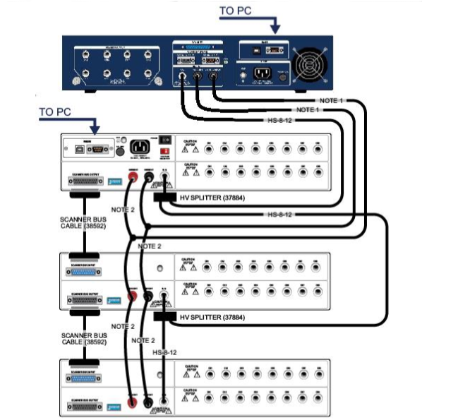
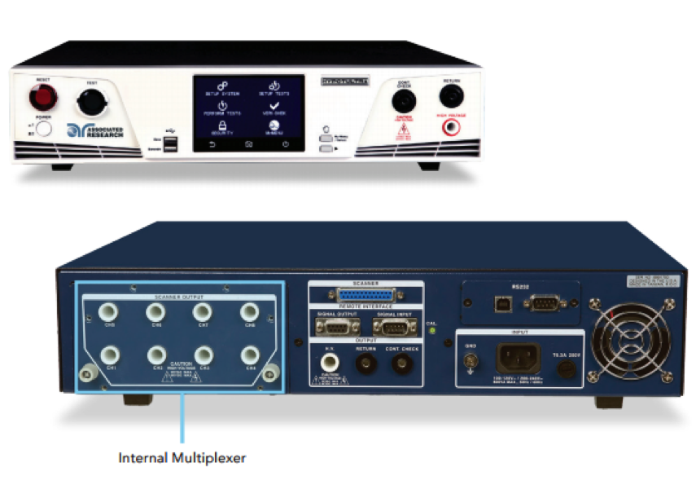
Using Multiplexers
External Multiplexers
Internal Multiplexers

Slide 14
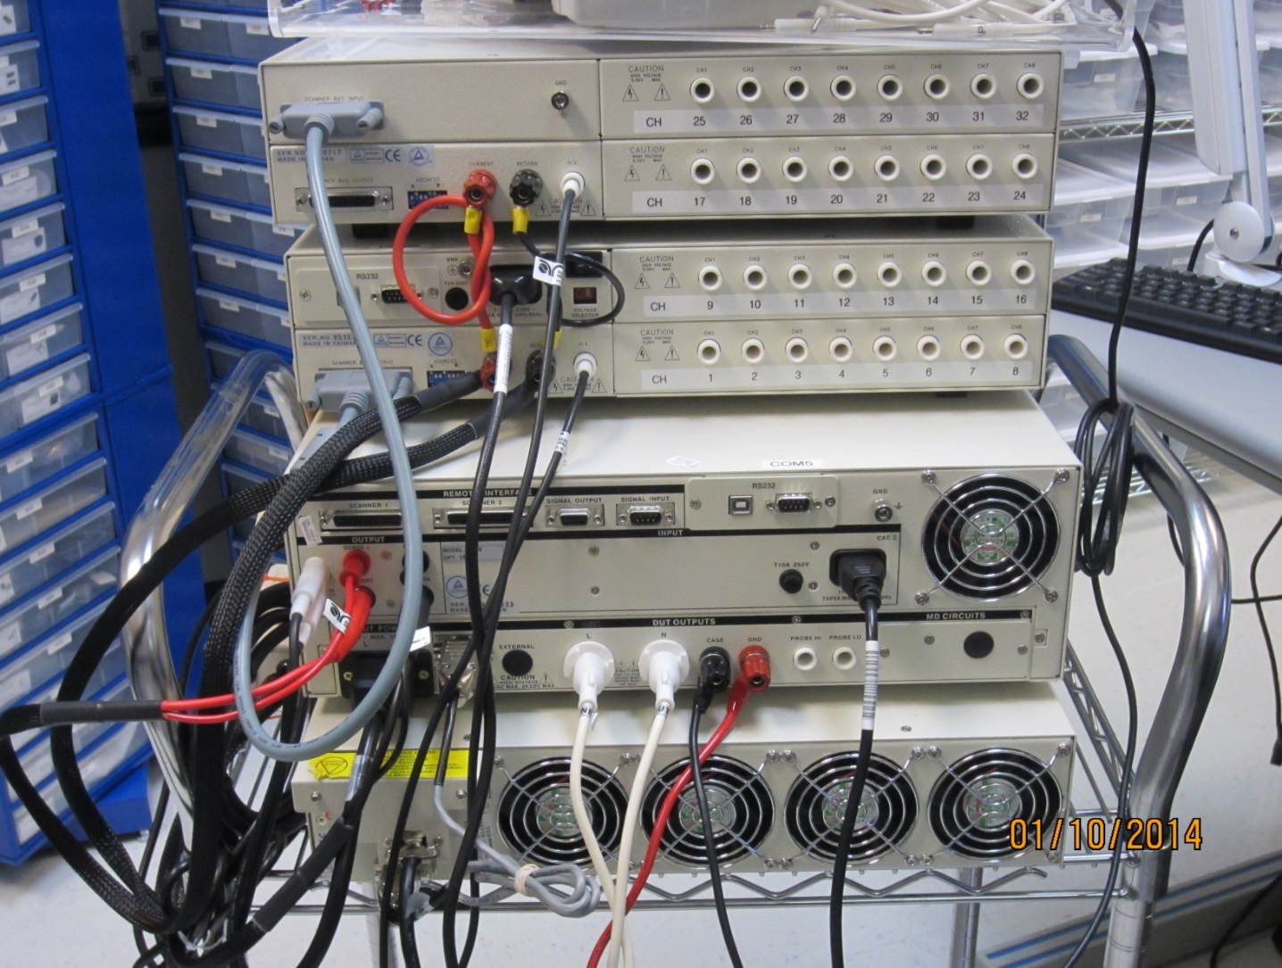
Using Multiplexers

Slide 15
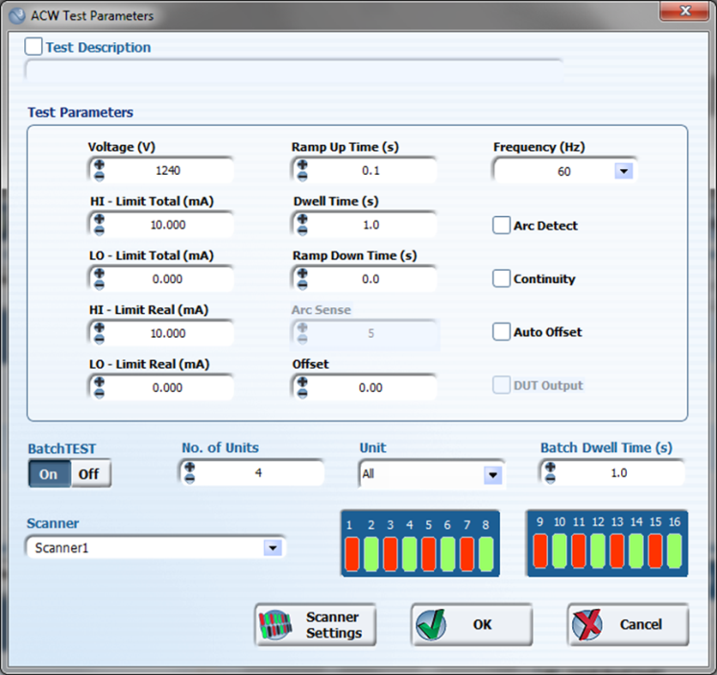
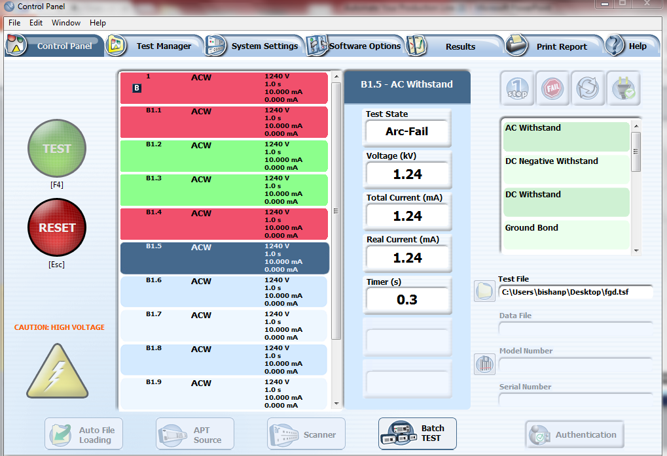
2. Batch Testing
Benefits of BatchTEST
Shave minutes off your test routines
Testing multiple DUT’s simultaneously
Combined with a scanning matrix
Test on a batch of DUT’s in a convenient 1-step test
Automatically test DUT to isolate the cause of the failure

Slide 16
3. PLC Control
Benefits of PLC Control
Operator Safety
Remote operation
Receives TEST, RESET, Memory Recall and Safety Interlock signals
Sends PASS, FAIL, PROCESSING and RESET OUT signals

Slide 17
4. Software Control
IVI Drivers - LabVIEW code -Remote BUS Command
Consistency and Scalability
Ease of use and less error prone
Plug and play (LabVIEW)
Pre-built example code
Full control of all functionality of the test instruments

Slide 18
4. Software Control
In addition to using multiplexers for multi-point testing, using a control software can allow users to set up a fully automated test system
This custom software allows full control of the test instrument and has the capability to record and log test data/results, print direct test reports with various filters and provide a very user friendly interface
Software can include security and user profiles perfect for laboratory or production line testing

Slide 19
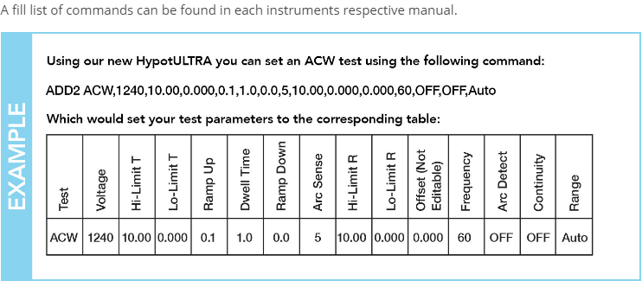
4. Software Control
Sample BUS Command

Slide 20
POLL QUESTION

Slide 21
5. Autoware®3
Instrument Control Software

Slide 22
Autoware®3
Instrument Control Software

Slide 23
Autoware®3
Instrument Control Software

Slide 24
Autoware®3
Instrument Control Software

Slide 25
AW3 Demo

Slide 26
6. Autoware®3
Test Data and Results Capture

Slide 27
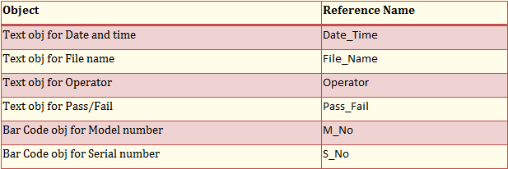
6. Result Printing

Slide 28
Contact Us
If you would like a copy of this presentation please email Brittany Socha at brittany.socha@arisafety.com
Check out our website for more information arisafety.com

Slide 29
WEBINAR SCHEDULE COMING SOON
Check Out Webinar Archive

