Slide 1


Slide 2


Slide 3
Webinar Notes
  Please use the Q & A utility to ask us any questions concerning
  the material being presented.
  Please contact Brittany Socha- chat line or email brittany.socha@arisafety.com if you would like a copy of the presentation.

Slide 4
The Hipot Test: Learning Objectives
Understanding the Hipot test
What is hipot test?
Hipot Test
Requirements
Test Parameters
Hipot Test
Considerations
and Failures
Leakage Current and Dielectric Breakdown
What is tested?
Arc Detection
Understanding the Hipot test
What is hipot test?
Hipot Test
Requirements
Test Parameters
Hipot Test
Considerations
and Failures
Leakage Current and Dielectric Breakdown
What is tested?
Arc Detection

Slide 5
The Hipot Test
The Dielectric Voltage-Withstand Test is commonly known as the Hipot test.
Hipot test is the most common type of electrical safety test.
Designed to verify that the insulation of a product is adequate enough to withstand high voltage.
The test is performed by stressing the insulation of the product far beyond what it would encounter during normal use.
Hence, the term “voltage withstand test”.
The hipot test is performed at high voltage to test the insulation of a product.

Slide 6
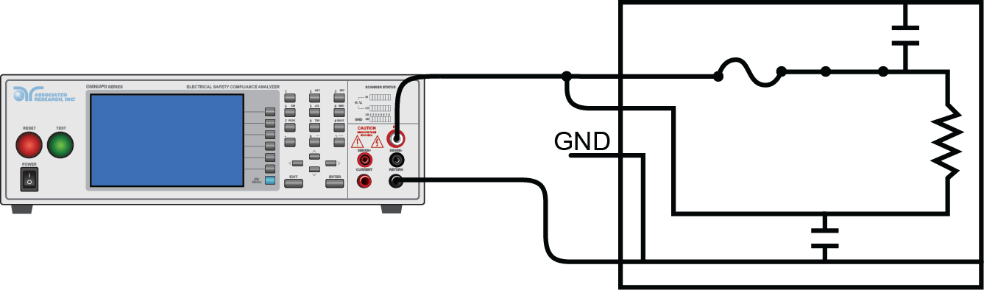
The Hipot Test
The diagram shows a basic circuit used for hipot test.
It is a deliberate application of high voltage potential between the current carrying conductors and any exposed dead-metal.
The resulting leakage current is measured to determine whether a product’s insulation is able to withstand the high voltage without breaking down.
This test verifies that the insulation of a product is capable of protecting the user from any leakage currents as a result of an electrical fault within the product.
Leakage current is gives a measure of the product’s insulation quality.

Slide 7
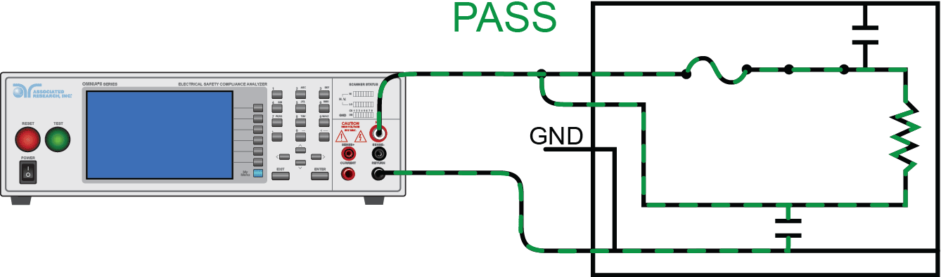
The Hipot Test
Hipot test PASS condition.
The insulation is able to withstand the high voltage and does not break down or does not allow excess leakage current to flow on the surface of the product under test.
Quality insulation will not allow excess leakage current to flow on a product’s surface.

Slide 8
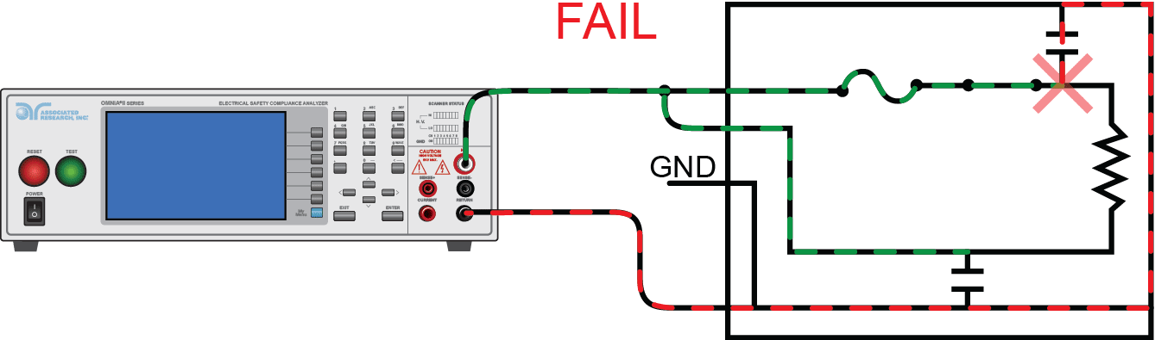
The Hipot Test
Hipot test FAIL condition.
Insulation breakdown results in excessive leakage to the chassis of the DUT.
Poor insulation will breakdown and dangerous leakage current can flow on the surface of a product.

Slide 9
The Hipot – A Versatile Test
When performed as Type tests Hipot tests are helpful in finding various important defects.
Nicked or crushed insulation, stray wire strands or braided shielding.
Conductive or corrosive contaminants around the conductors.
Terminal spacing problems and tolerance errors in cables.
Inadequate creepage and clearance distances introduced during the manufacturing process.

Slide 10
The Hipot – A Versatile Test
The production-line hipot test is used to determine whether the construction of a production unit is about the same as the construction of the unit that was subjected to type testing.
Some of the process failures that can be detected by a production-line hipot test include, for example, a transformer wound in such a way that creepage and clearance have been reduced.
Such a failure could result from a new operator in the winding department.
The hipot is more than just a go/no-go test. It can be used to find various insulation problems.

Slide 11
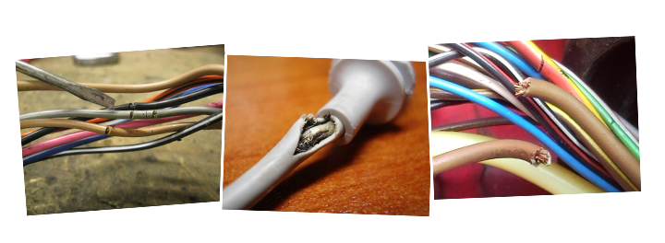
The Hipot – A Versatile Test
Scrapes • Pinholes • Spacing • Crimps • Heat
Material Build-up • Moisture
Insulation of any electrical device can become weak over time.

Slide 12
The Hipot Test
The best indication of a dielectric breakdown is a leakage current measurement significantly higher than the nominal current measurement.
Test voltage, the product being tested and the capacitance of the product can all impact the total leakage current measurement.
When we perform a hipot test on a product, we can think of the product as a giant capacitor.
The voltage is applied between the mains input and the chassis of the product which are separated by the insulation, which is just like a capacitor.

Slide 13
Test Voltages
Unless and otherwise stated by the safety standard, a good rule of thumb to calculate the hipot test voltage is: (2 X Nominal Input Voltage) + 1000V
In some cases, safety agency requirements call out for hipot test voltage for certain devices.
For example, medical equipment with applied parts that have direct contact with a patient is tested at 4000V or 4KV.
Most double insulated (Class II) products are subjected to design tests at voltage levels much higher than the rule of thumb described above.
Hipot test parameters are called out by the standards but when in doubt, use the rule of thumb.

Slide 14
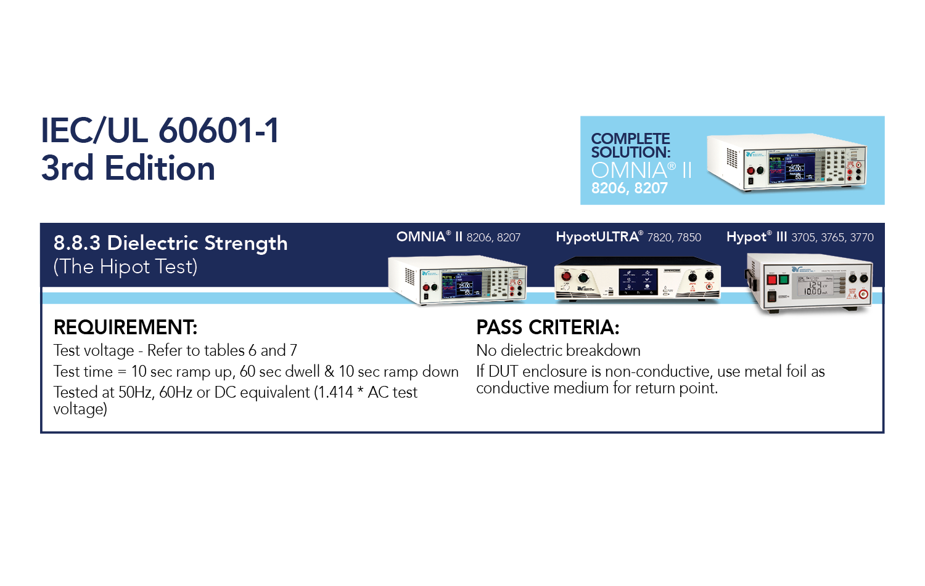
Production Hipot test parameters may differ from Type test parameters.

Slide 15
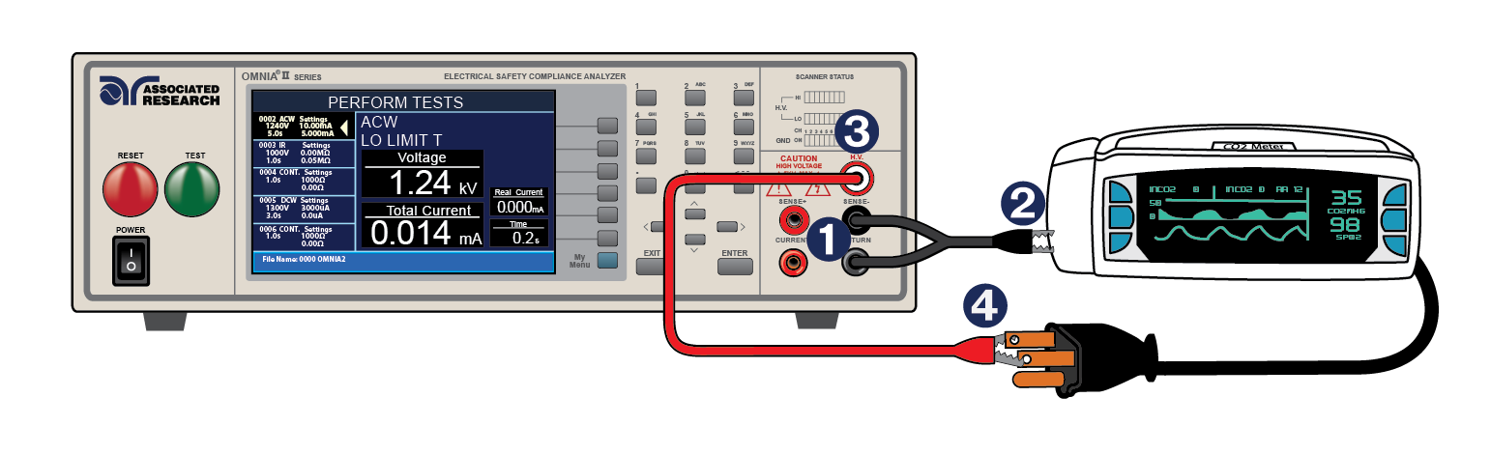
Class I vs. Class II Application

Slide 16
Poll Question 1
Maybe quiz question on class II

Slide 17
Failure Detectors
Breakdown
400μsec interrupt
Shorts and Breakdowns
Leakage Limits
Leakage high and low limits
100msec samples
Arc Detection
Leakage high and low limits
100msec samples
Each failure detector has a priority on the instrument. Shorts and breakdowns will always be detected with a high speed interrupt. Leakage limits will trigger a failure if leakage current strays from user set values. Arc detection is a extra feature which is enabled.

Slide 18
AC vs. DC Hipot Testing
Depending on the product being tested and the test standard, the hipot test can either be performed using AC or DC potential.
Both AC and DC hipot tests have inherent advantages and disadvantages which are evident depending on the product being tested.
It is important to understand the difference between the nature of AC and DC voltage/current.
AC or DC
Differences
Which to use?

Slide 19
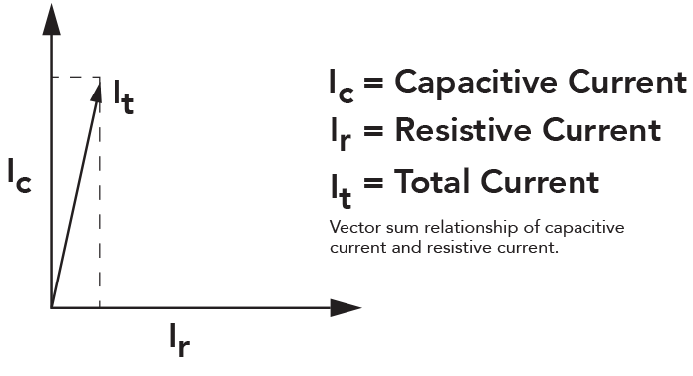
Total Leakage Current
The leakage current that is measured by most AC hipot testers is the vector sum of the resistive leakage current and the reactive leakage current.
Some Associated Research hipot testers are capable of displaying real and total leakage current for manufacturers who require extra information.
Vector Sum Relationship
The hipot is more than just a go/no-go test. It can be used to find various insulation problems.

Slide 20
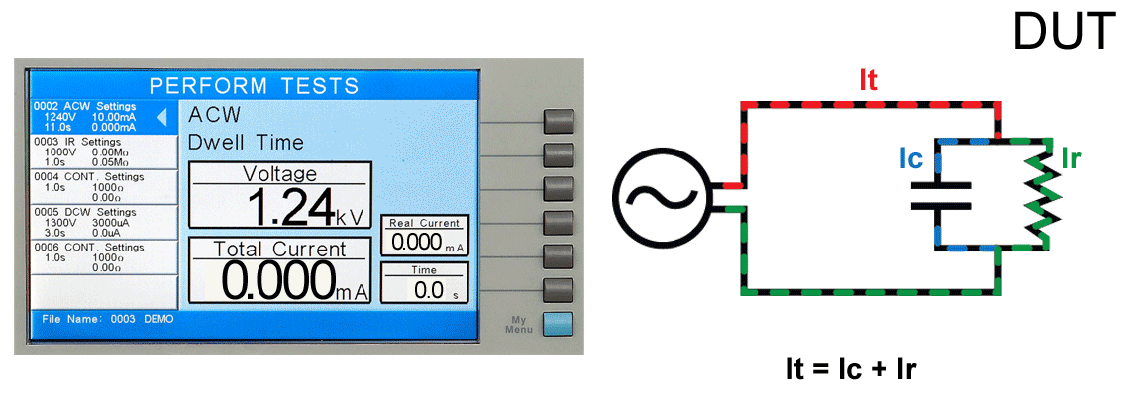
Leakage Current
Leakage current is the stray current that actually flows through the insulation. It is undesired current that we want to quantify to better understand the quality of an insulation barrier.

Slide 21
AC vs. DC
AC HIPOT ADVANTAGES | DC HIPOT ADVANTAGES
No ramping of voltage required due to the changing polarity of the AC voltage | Can be performed at a much lower current level with less risk to the operator
Discharging the DUT is not necessary | Often easier to perform on capacitive DUT’s
Insulation is stressed in both polarities | Leakage current measurement is purely real
Measures both real and reactive current | Cost effective
Commonly accepted by safety agencies | Not always accepted by safety agencies

Slide 22
500 VA Hipot Testing – By the Standards
Standard | Description | Hipot Requirements
IEC 61010-1 | Equipment for Measurement, Control and Laboratory Use | The generator shall be able to supply a power of at least 500 VA. The test voltage is raised uniformly from 0 V to the specified value within 5 s and held at that value for at least the specified time.
IEC 60598-1 | Luminaires | A voltage of substantially sine-wave form, with a frequency of 50 Hz or 60 Hz and the value specified in Table 10.2, shall be applied for 1 min across the insulation shown in that table. Short circuit current shall be at least 200 mA. The overcurrent relay shall not trip when the output current is less than 100 mA.
IEC 60335-1 | Household Appliances | The insulation is subjected to a voltage of substantially sinusoidal waveform having a frequency of 50 Hz or 60 Hz for 1 min…No breakdown shall occur. Tests run at 4000V or less require 100mA trip limit and 200mA short circuit current.

Slide 23
500 VA Hipot Testing
VA Rating - Certain standards require the use of a 500VA hipot transformer
Energy and Breakdown - Originally this was required to ensure hipot voltage output remained constant under varying line and load conditions
High Leakage Applications - Higher mA output may also be required for high leakage currents. For example, a 2000m length of cable may have 60mA of leakage.
Most Associated Research instruments have a 5000V output. Thus, the instruments have a 100mA trip current rating and 200mA short circuit current rating.

Slide 24
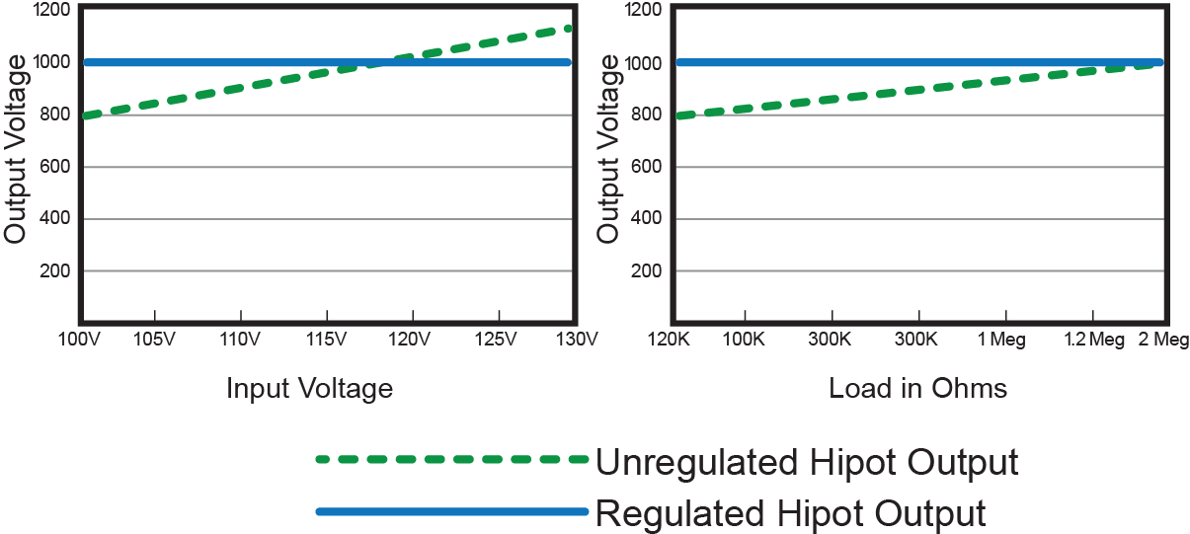
Line Vs. Load Regulation
If the hipot circuit is too heavily loaded or the input voltage drops, the hipot test voltage can dip causing an improper hipot test.

Slide 25
How to Set Leakage Current Limits?
Perform & Record
Perform hipot on known good products. Record all results
Calculate
Calculate the average leakage current value for these products
Add
Take 25% of this number and add to the average value. This is your Hi-Limit
Use that same 25% and subtract from the average value. This is your Lo-Limit
Subtract
Say I test 10 DUTs and calculate an average leakage current of 5.5mA. My limits would be:
Hi-Limit → (5.5mA)*0.25 = 1.375mA → 5.5mA + 1.375mA = 6.88mA
Lo-Limit → 5.5mA – 1.375mA = 4.13mA

Slide 26


Ramp HI and Charge-Lo
DC Hipot Test – At test start, there will be inrush current. Once the insulation is charged (full test potential), the leakage current drops off to near zero mA.
Ramp-Hi will ignore inrush current values so that the DC hipot does not falsely fail
Charge-Lo monitors hipot circuit with DUT attached. The Charge-Lo circuit takes half the inrush current value and substitutes as a low limit check.
These features are used with a DC hipot or IR test. Due to the nature of a DC withstand test, setting high and low leakage limits can prove difficult. These features compensate for this difficulty and allow the user to properly monitor the limits.

Slide 27

Contact Us
If you would like a copy of this presentation please email Brittany Socha at brittany.socha@arisafety.com
Check out our website for more information arisafety.com

