Slide 1
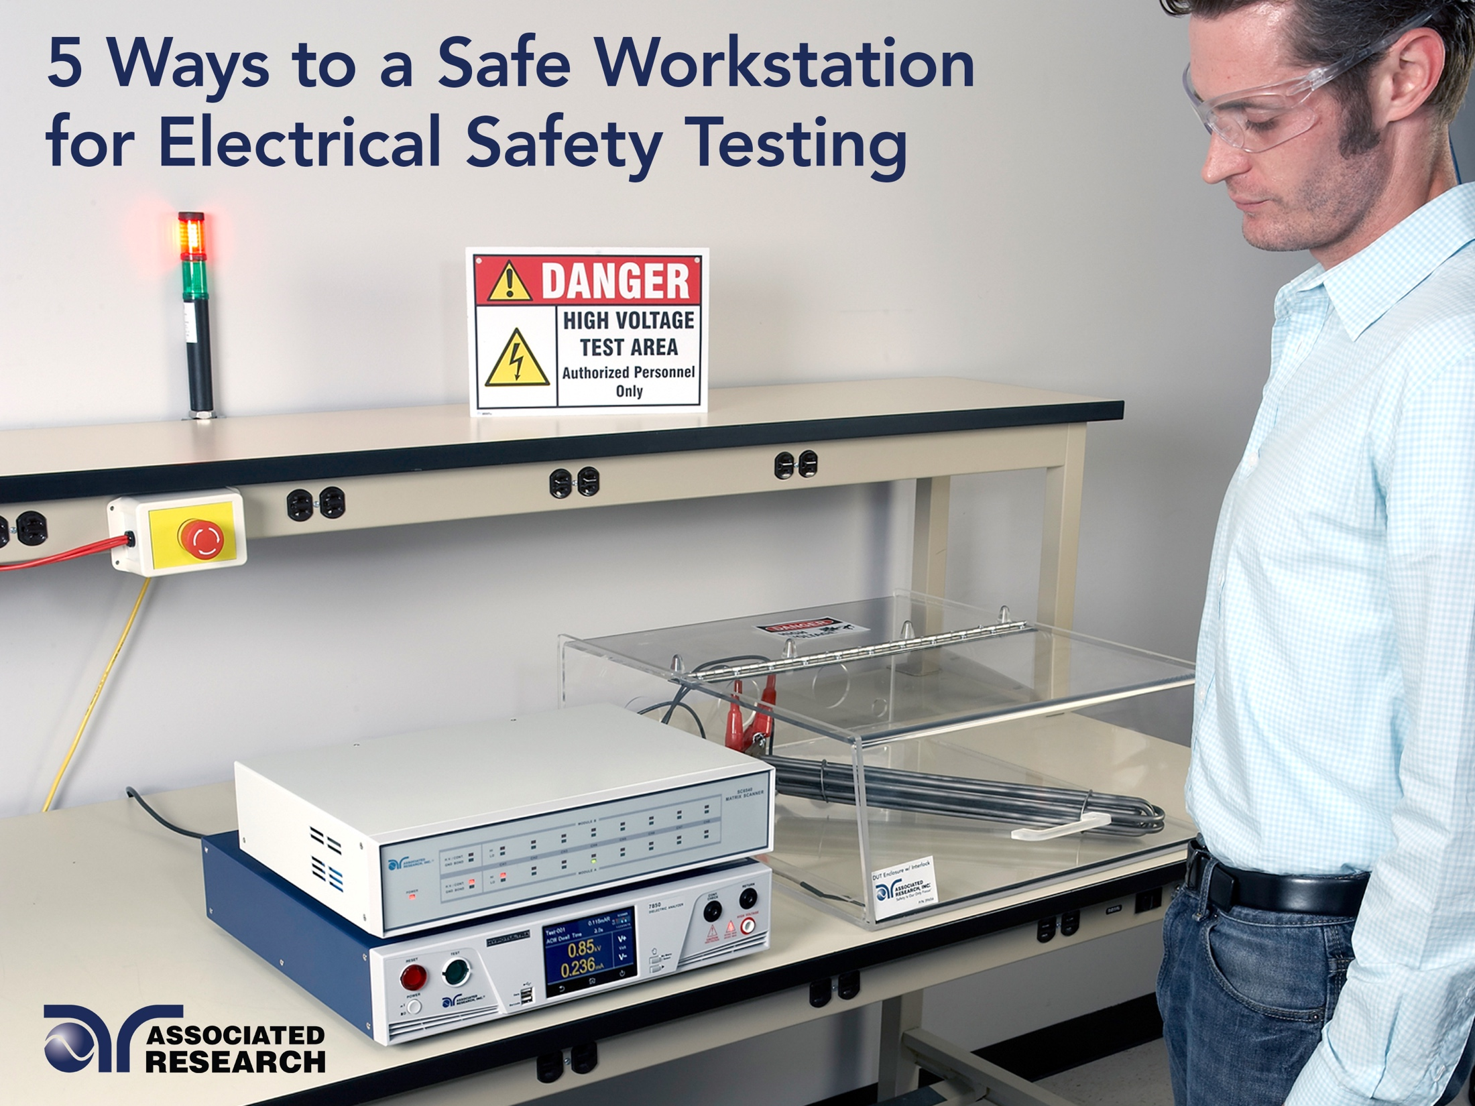

Slide 2



Meet Our Team
Anthony Arroyo
Syed Abidi
Allison Oba
Presenter
Applications Engineer
Panelist
Applications Engineer
Organizer
Marketing Coordinator
Copyright 2016 Associated Research

Slide 3
Webinar Notes
  Please use the Q & A utility to ask us any questions concerning the material being presented.
  Any questions related to running of the meeting (audio and visual, etc) can be addressed to the host (Allison Oba) through the chat line.
  The Webinar is being recorded and will be available to view usually
  within a day on our website.
  Please contact Allison Oba - chat line or email allison.oba@arisafety.com if you would like a copy of the presentation.
Copyright 2016 Associated Research

Slide 4
Previous Webinar Recap – Electrical Safety Testing 201
Testing with Multiplexers
Batch testing
Data Collection
Collecting and managing data
Software control and remote operation
Common Electrical Safety Tests
Hipot testing
Ground Bond/Ground Continuity testing
Touch Current testing
Label printing
Methods of data acquisition
Copyright 2016 Associated Research

Slide 5
Safe Workstation – Learning Objectives
Operator
10 Things a Qualified Operator Should Know
Building Safeguards
Stations with positive protection
Additional Safety Methods
Additional means for safe testing -PPE
Safety
Shock Hazards
Effects of Current on the Human Body
Station without positive protection
Training Resources
Copyright 2016 Associated Research

Slide 6
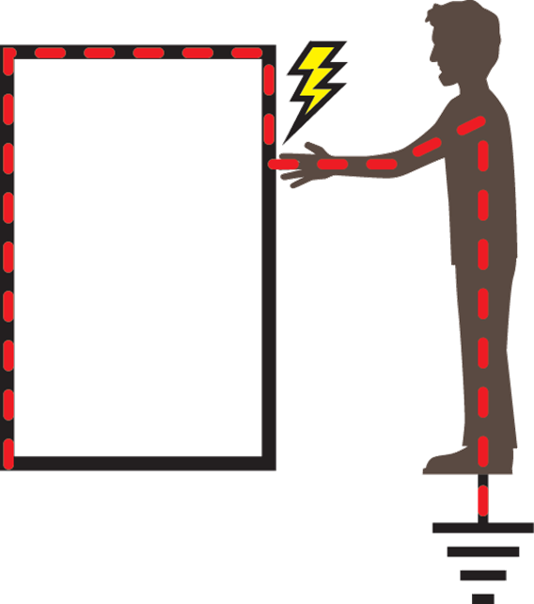
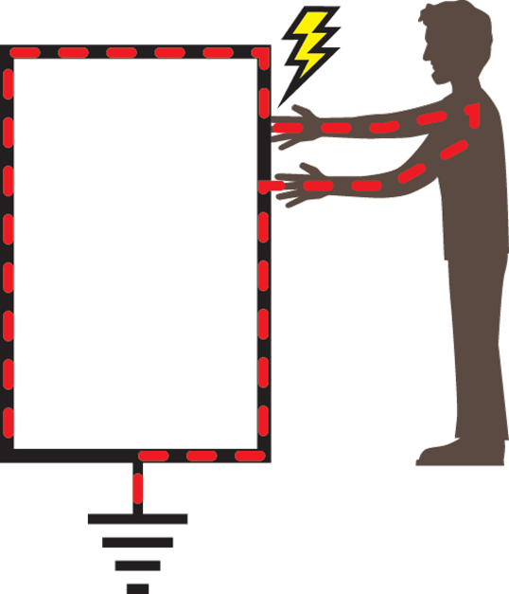
Potential Shock Hazards
Contact is made with one point of a circuit and ground.
Contact is made with a “hot” metallic part while a person is
at ground potential.
Contact is made with two points of a circuit.
Copyright 2016 Associated Research

Slide 7
Severity of Electric Shock is Influenced by
Physical condition & response.
The path of the electrical current through the body.
The duration or length of time the person is exposed.
The magnitude of the voltage and current flow.
The frequency of the supply voltage.
Copyright 2016 Associated Research

Slide 8
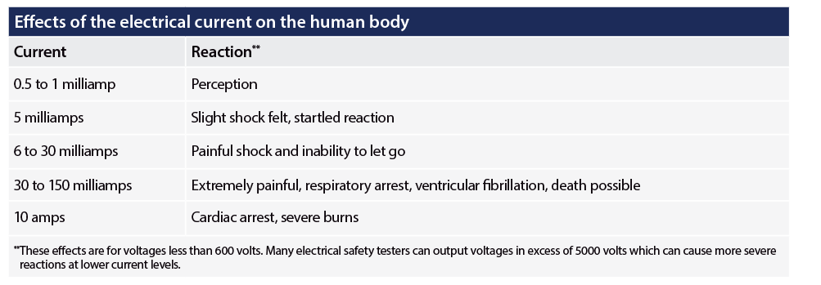
Effects of Electrical Current on the Body
Copyright 2016 Associated Research

Slide 9
Human Body Resistance
The human body on an average has about 1000 to 1500 ohms resistance.
The outer layer of the skin provides the largest resistance.
The skin has a breakdown voltage at which it is simply “punctured” leaving only the lower resistance body tissue to impede the flow of current in the body.
Copyright 2016 Associated Research

Slide 10
Poll Question 1
How many training hours do your operators receive before using test equipment?
Copyright 2016 Associated Research

Slide 11
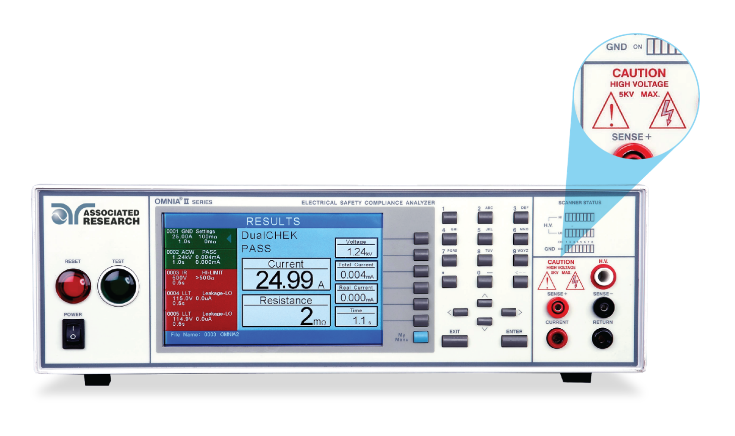


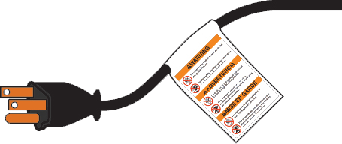
The Qualified Test Operator – 10 Things to Know
Determine if exposed conductor
is energized.
Know how to use the equipment,
read the specs!
Copyright 2016 Associated Research

Slide 12



The Qualified Test Operator – 10 Things to Know
Understand approach distances and corresponding voltage
- AR instruments can output 10 – 20,000 VAC or VDC
Understand the relationship between electrical hazard and
possible injury
- Effects of electrical current on the human body
Know the safety features of the equipment and how to utilize
them
- SmartGFI, interlock and automatic discharge
Copyright 2016 Associated Research

Slide 13
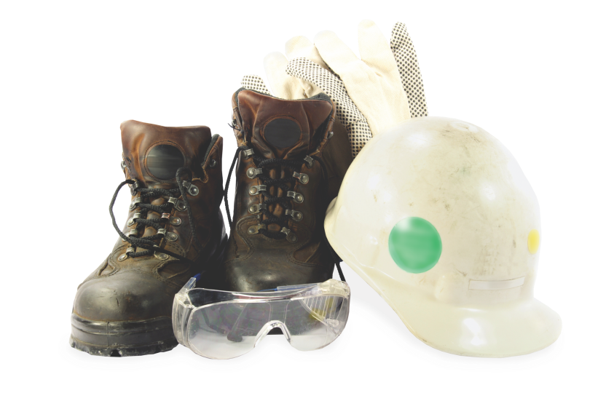
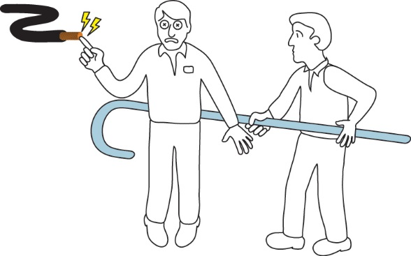
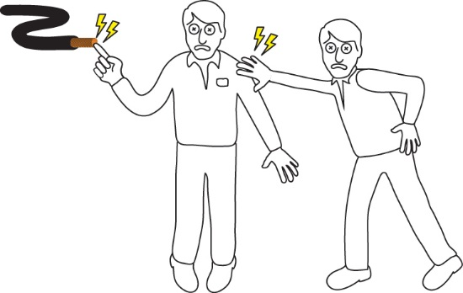

The Qualified Test Operator – 10 Things to Know
Determine if PPE is necessary, what type and how it’s rated
Know the methods of release for victims who are being shocked.
DO NOT TOUCH SOMEONE
WHO IS BEING SHOCKED.
Copyright 2016 Associated Research

Slide 14



The Qualified Test Operator – 10 Things to Know
Understand that the tester is a variable voltage power source.
Contacting the DUT during the test can result in a dangerous shock hazard.
Know the importance of discharging the DUT
There must be a complete path for an instrument to discharge. Be wary all leads are connected for testing.
Each step in a work plan must be executed
DO NOT take shortcuts
Copyright 2016 Associated Research

Slide 15
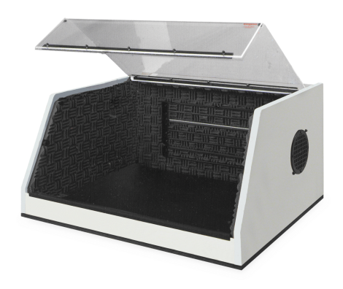
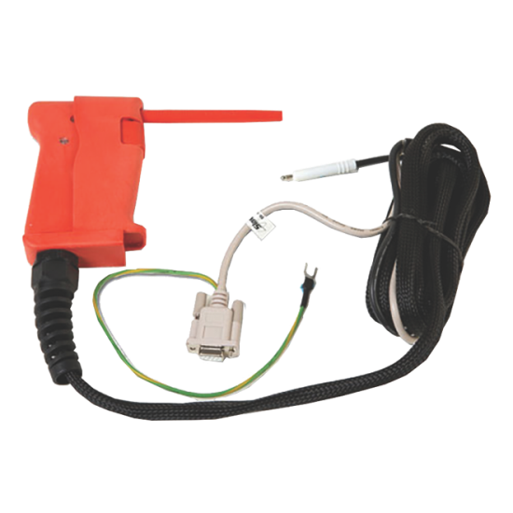
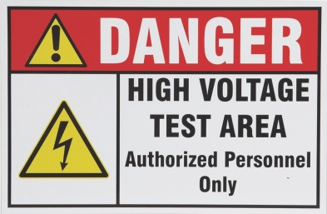
Building Safeguards into a Station
Enclosure designed to remove shock hazard
Cabling and insulation
Use PPE (Personal Protective Equipment)
Be aware of all nearby hazards

Slide 16
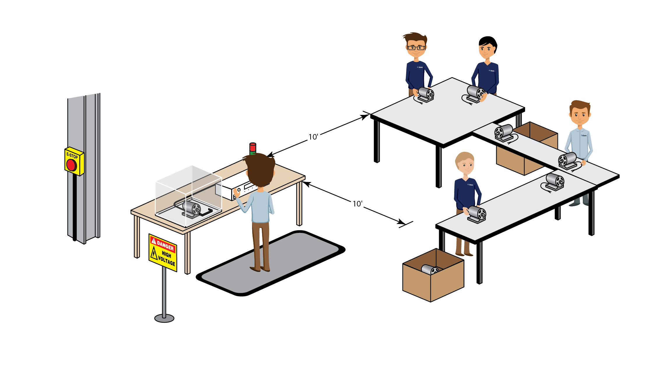
Methods of Safety Testing
Testing Station with Positive Protection
Copyright 2016 Associated Research

Slide 17
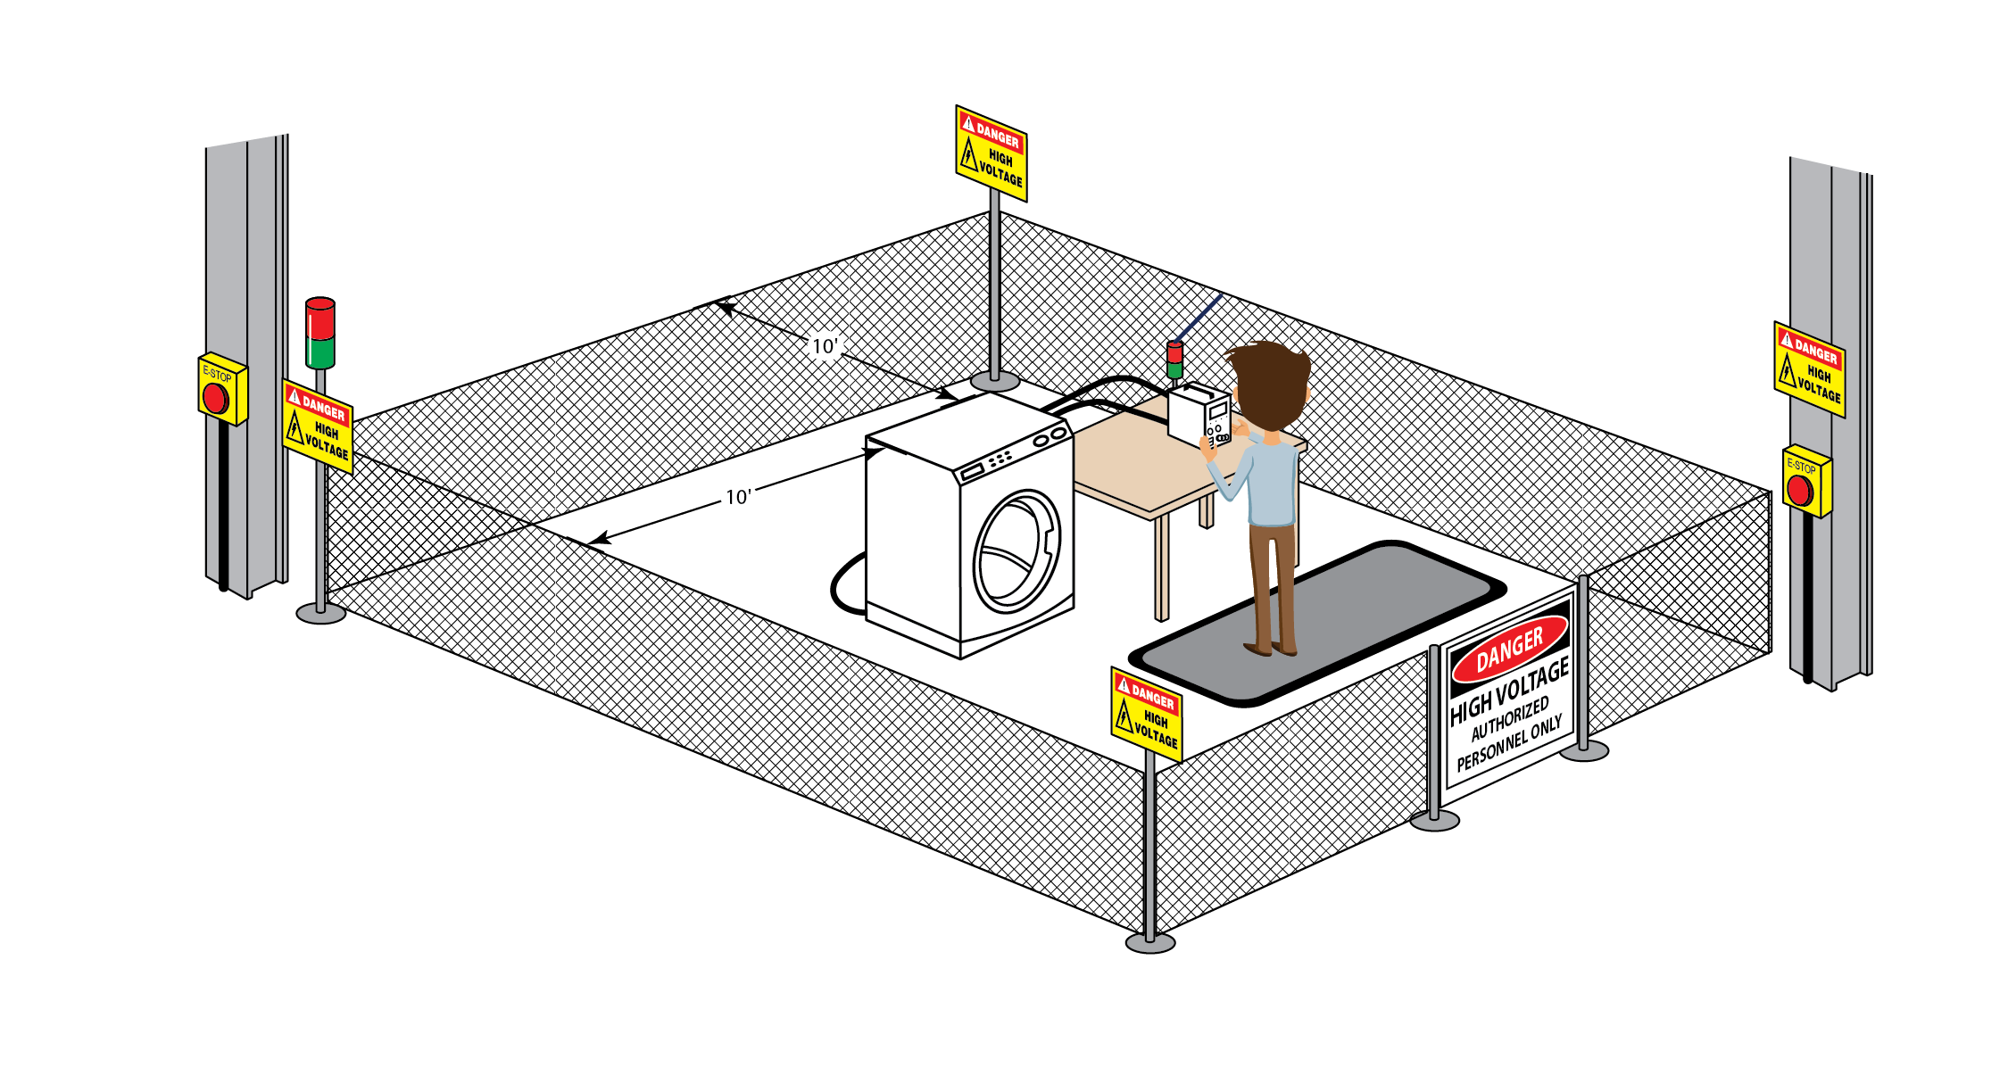
Methods of Safety Testing
Testing Station with NO Positive Protection
Such a station does not
protect the user from touching the DUT during a test.
Copyright 2016 Associated Research

Slide 18
Poll Question 2
What PPE Accessories do you utilize in your workstation?

Slide 19
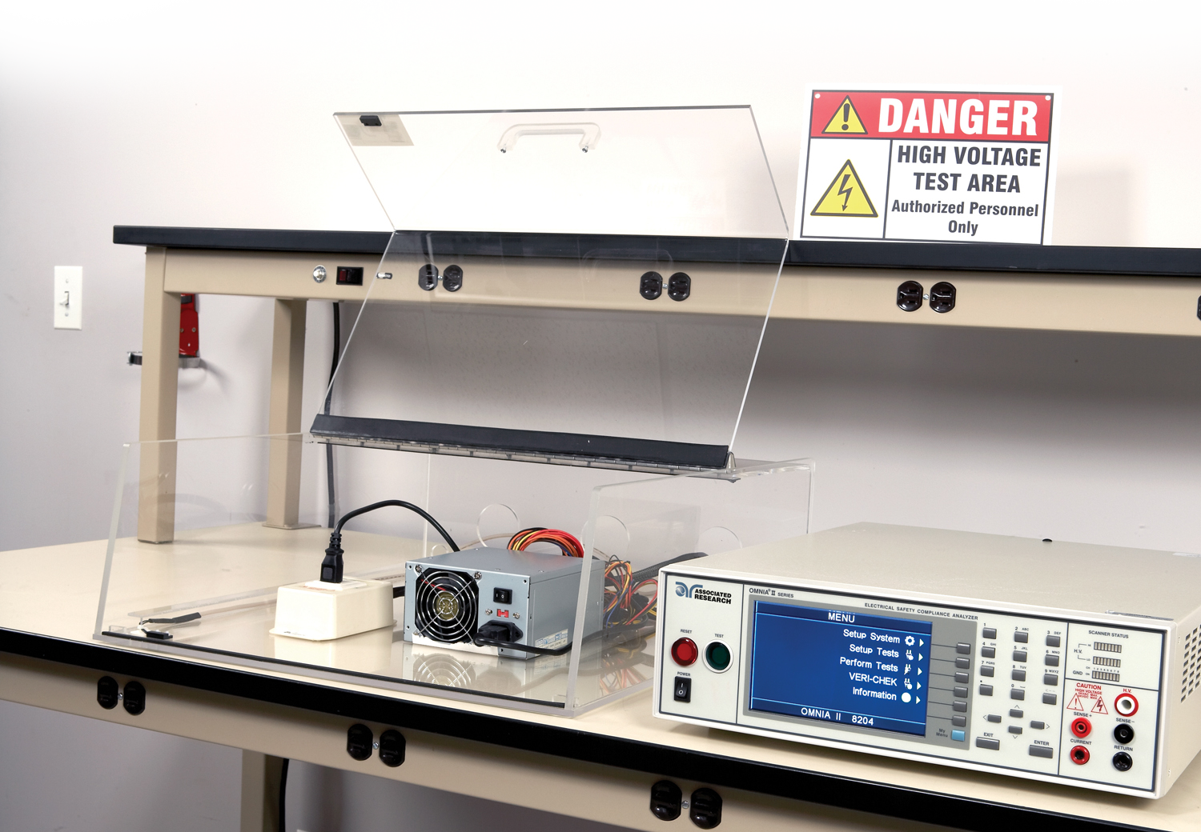
Test Station with Positive Protection

Slide 20
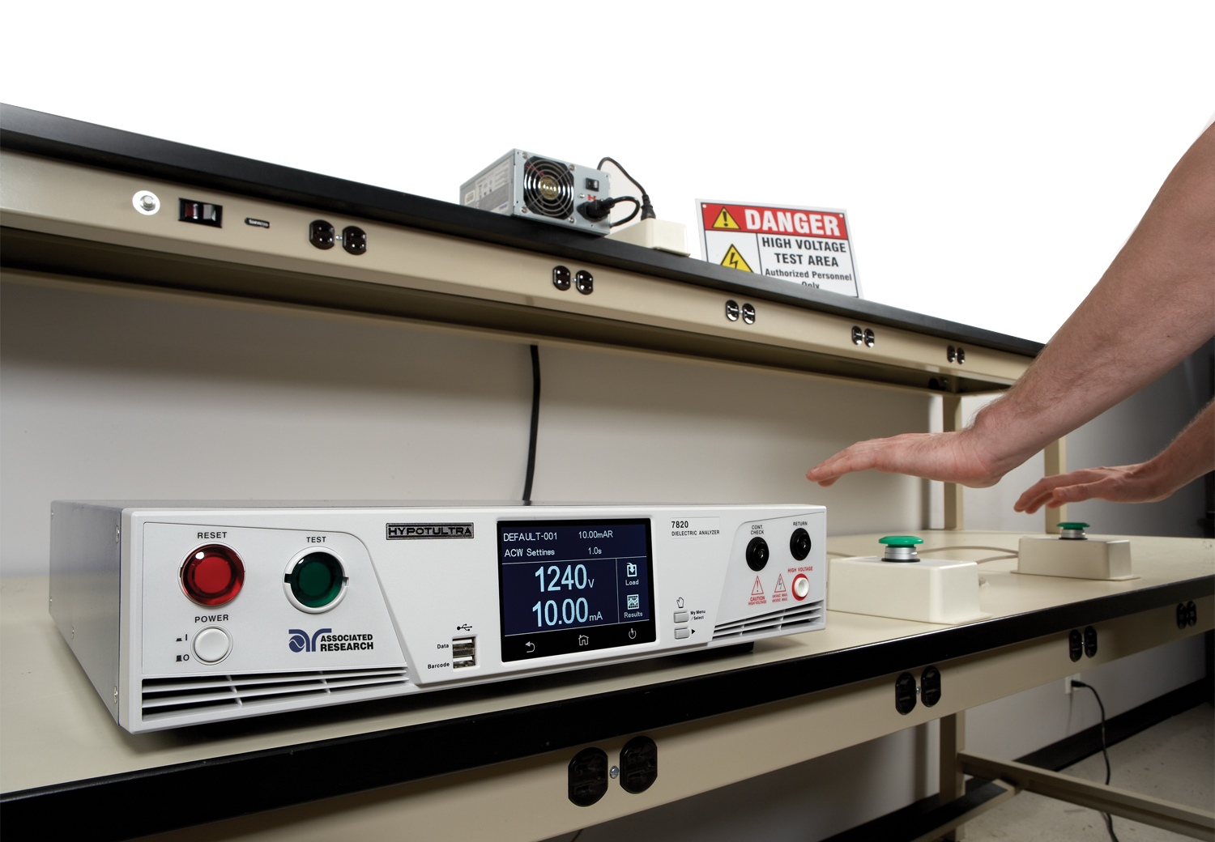
Test Station without Positive Protection

Slide 21
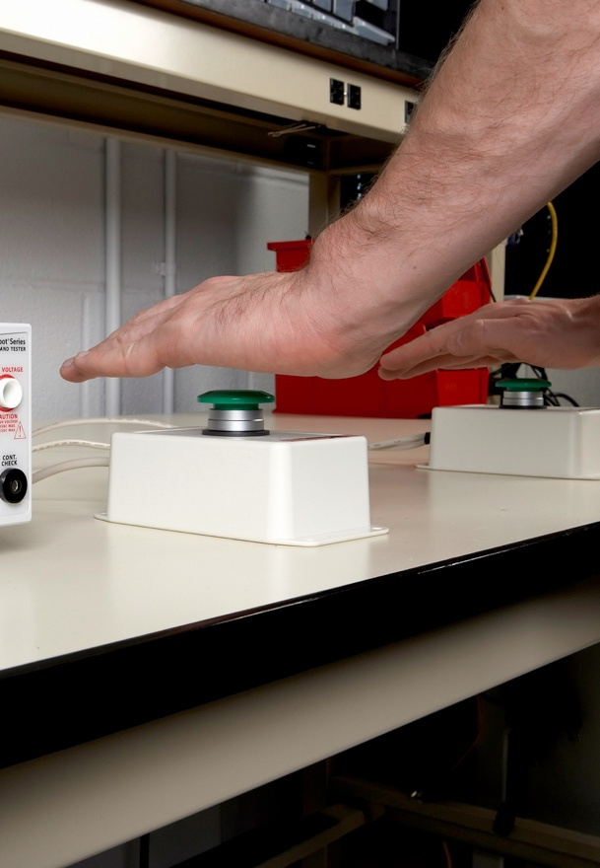
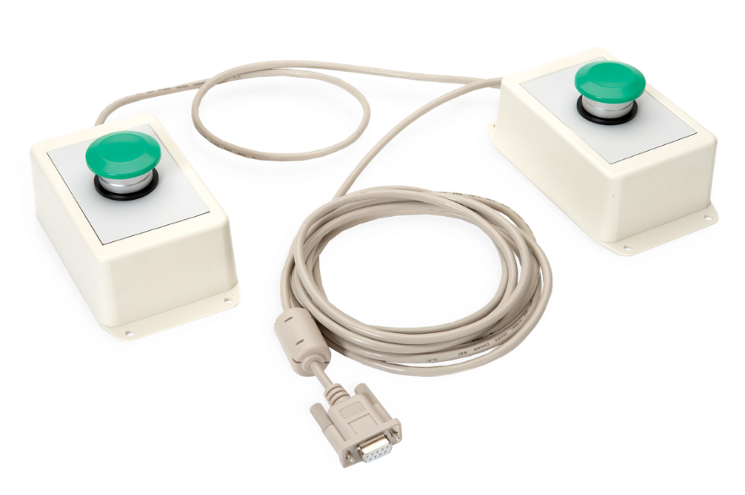
Additional Methods for Operator Safety
Dual Palm Remote Switch
This does NOT allow the operator to touch the DUT as their hands must remain on the test switches during the test.
Simultaneous activation – activation of both within 0.5 seconds.
Copyright 2016 Associated Research

Slide 22
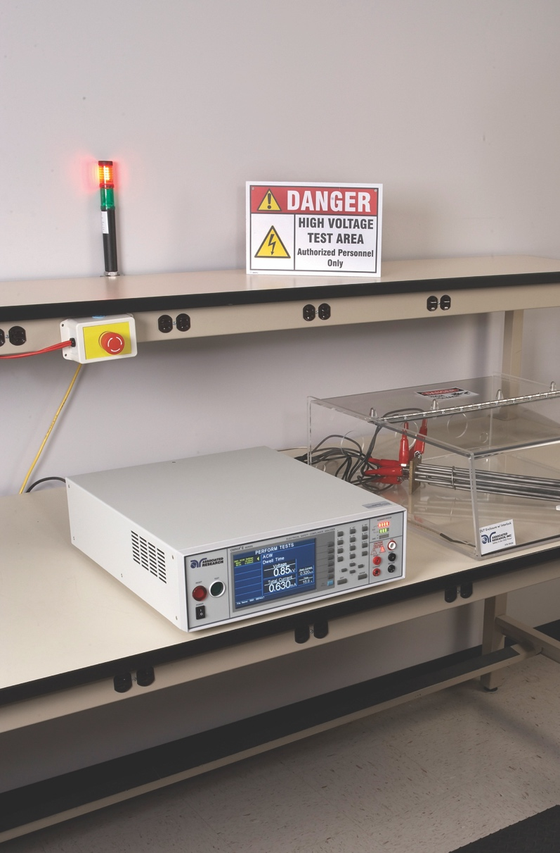
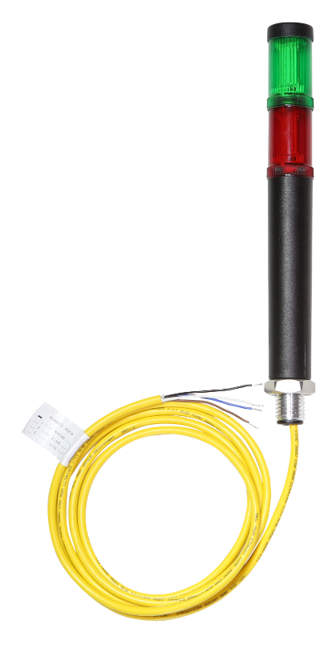
Additional Methods for Operator Safety
Signal Lights
Mounted lights warn operators
in the nearby area to the status
of the Hipot test and if
the instrument is
outputting high voltage.
Illuminates red when
test is active – mounted
in plain site for
entire work area.
Copyright 2016 Associated Research

Slide 23
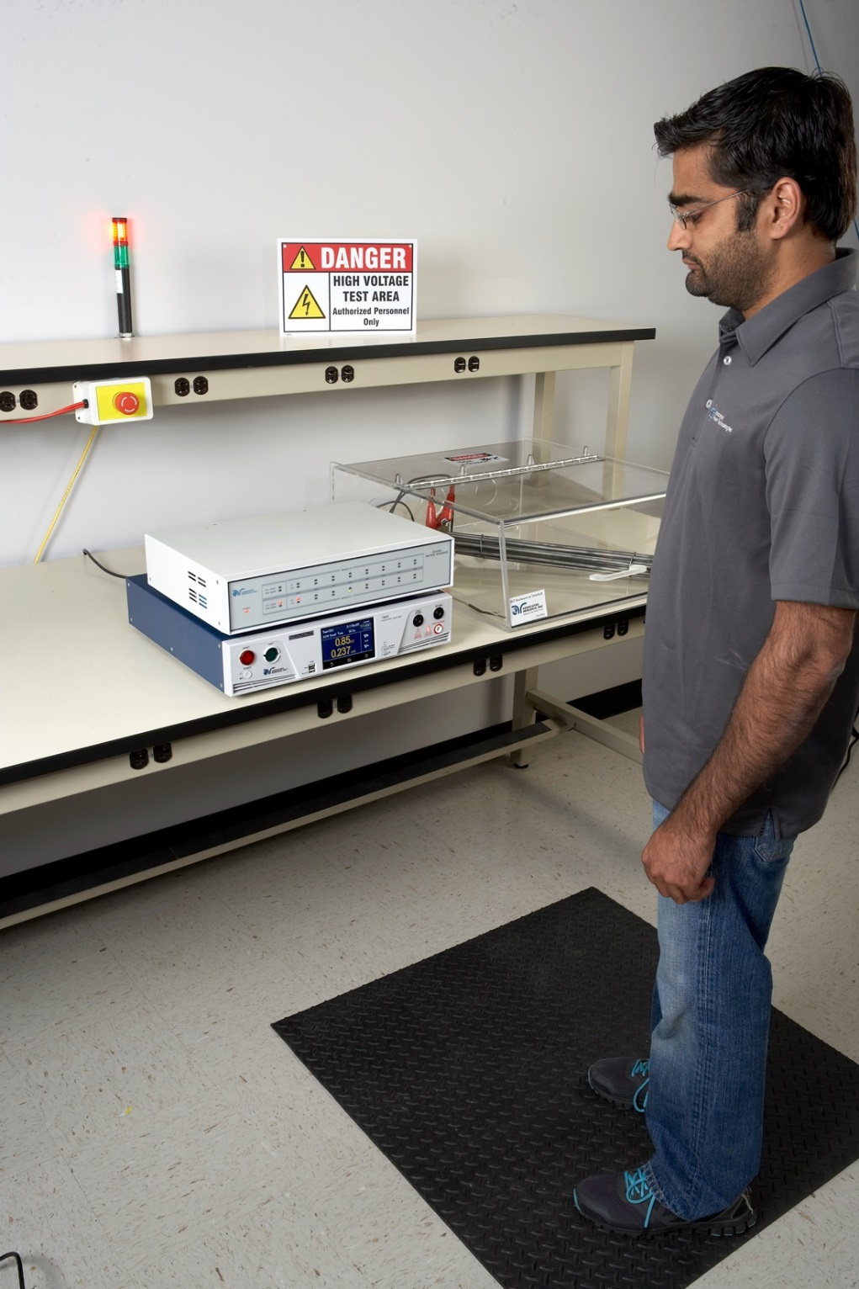
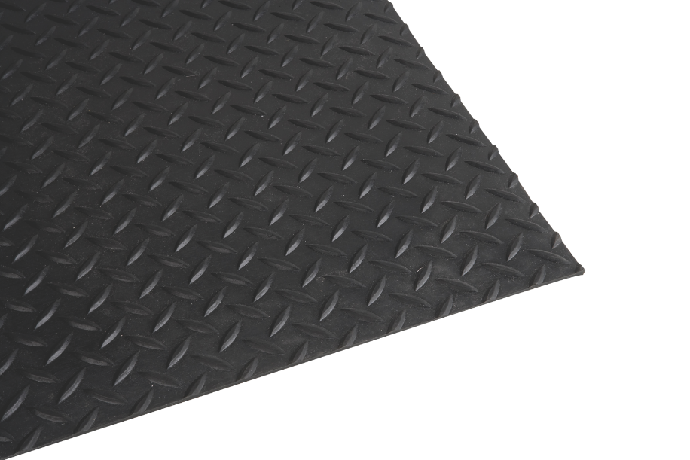
Additional Methods for Operator Safety
Insulation Mat
Isolates the operator from ground while testing which greatly mitigates he shock hazard.
Copyright 2016 Associated Research

Slide 24

Insert Video Title

Slide 25



Training Resources
OSHA 29 CFR part 1910.332 Subpart S
  Defines the training requirements for anyone exposed to voltages
  in excess of 50 volts
  Employees must be qualified to work on or near exposed
  energized parts
NFPA 70E: Standard for Electrical Safety in the
Workplace 2012
  Explains reason behind the rule and how to comply
  Safe work practices, PPE and lockout/tagout procedures
BS EN 50191:2010
  Erection and Operation of Electrical Test Equipment
  Defines recommended setups for electrical testing stations
Copyright 2016 Associated Research

Slide 26



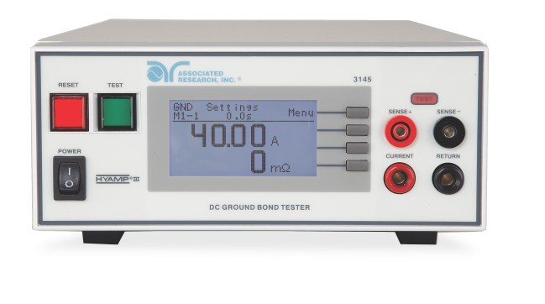
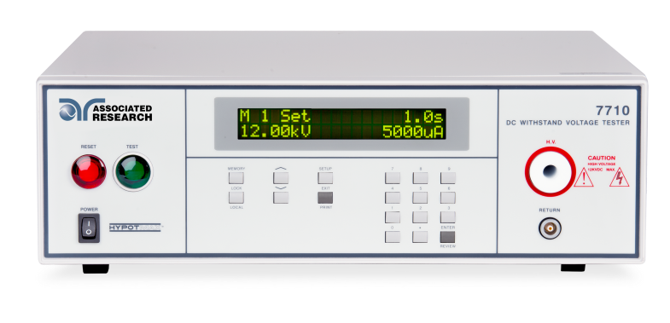
Contact Us
If you would like a copy of this presentation please contact Allison Oba at allison.oba@arisafety.com
Check out our website for more information arisafety.com
Follow Us!
Associated Research, Inc.
@ARHypot

